Slide 1
FOOD HUB
Group : WongnaiNAJA

Slide 2
FEATURES
Application for search healthy foods by
Names
Locations
Prices
Categories
Can share pictures and details of food
User can review about foods
Notify user about new or popular foods
Can vote healthy food separate by
General User
Expert User

Slide 3
ABOUT USER
Users can…
share pictures and details
review foods and locations
search foods or locations
General User can…
vote as General User
Expert User can…
vote as priority review

Slide 4
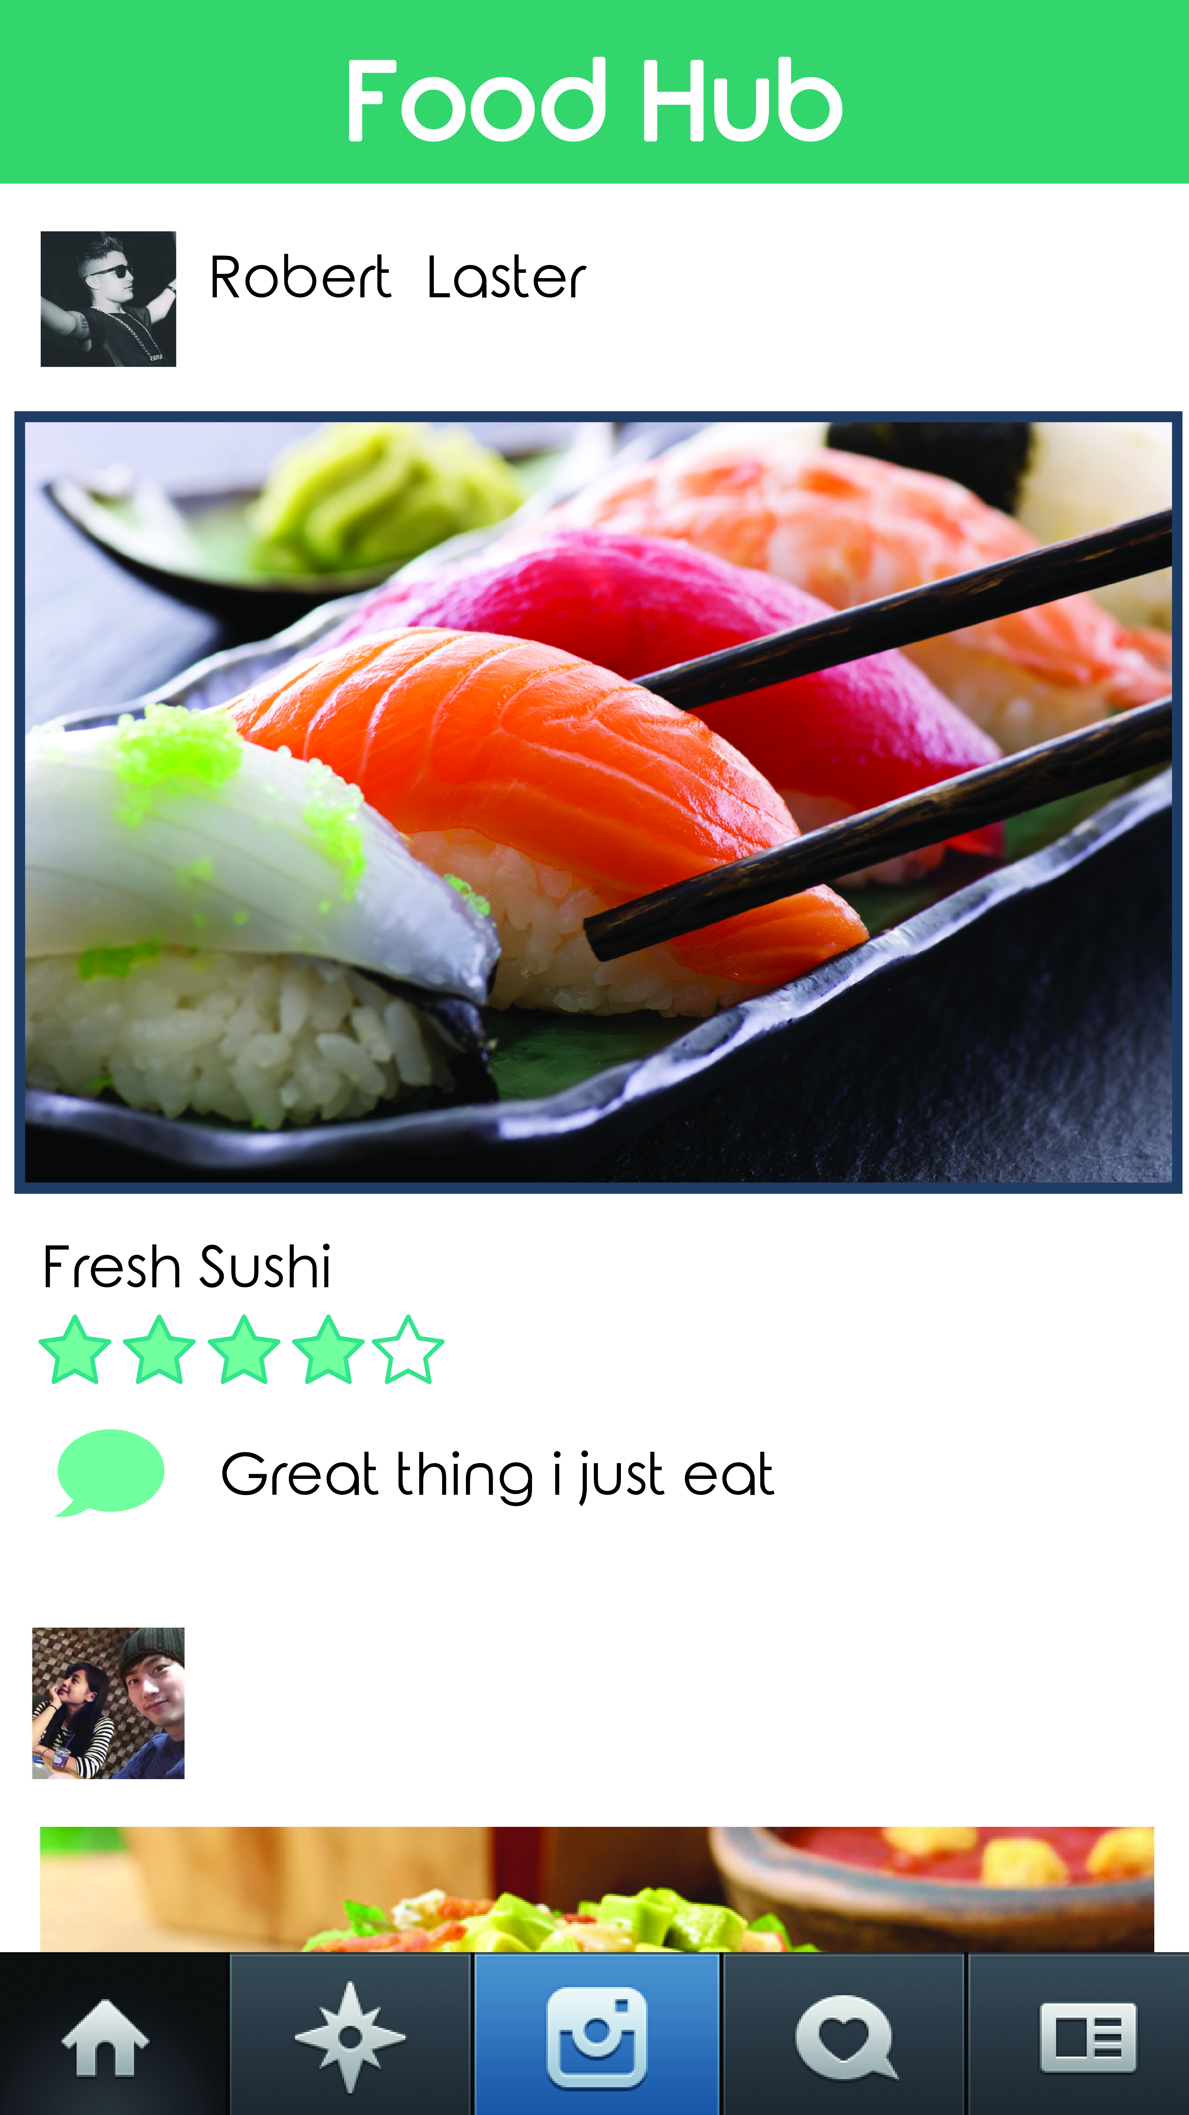
GUI

Slide 5
!!Thank you!!

